Slide 1

Team Details
Team name: SmartMess: Crowd-Aware and Data-Driven Mess Management System
Team leader name: Aryan Sisodiya
Team Members: Aryan Sisodiya (B25126), Daksh Rathi (B25132)
Problem Statement: Open Innovation

Slide 2

Team Details
Team name: SmartMess: Crowd-Aware and Data-Driven Mess Management System
Team leader name: Aryan Sisodiya
Problem Statement: Open Innovation
Team Member Details:
Aryan Sisodiya (Leader):
B25126
aryansisodiya091107@gmail.com
https://github.com/InfinityxR9/
Daksh Rathi:
B25132
iamdakshrathi@gmail.com
https://github.com/dakshrathi-india/

Slide 3
Brief about your solution and problem statement addressing
SmartMess is an intelligent mess management system designed to improve food quality, reduce wastage, and enhance the student dining experience using real-time data. The primary aim of the project is to analyze crowd levels in the mess by comparing live attendance with available seating capacity and predict the best time for students to have their meals. This helps avoid overcrowding, ensures smoother meal distribution, and prevents sudden high demand that often degrades food quality.
In addition, SmartMess enables students to provide food feedback, helping mess authorities continuously improve meal quality. The provided constructive and meal-specific feedback allows the mess to prepare food more accurately and significantly reduce wastage. Daily menus can be created and displayed digitally for easy access. Overall, SmartMess creates a more efficient, transparent, and sustainable mess ecosystem for both students and managers.

Slide 4
Opportunities
How different is it from any of the other existing ideas?
Our idea of SmartMess is different because it is a Data-Driven Solution, It predicts the crowd for next 15 minutes, using a simple Regression model, thus providing students an optimum time to go to the mess and prevent over-crowding problems.
SmartMess, is not just a plain review system meant for increasing mess quality, but a comprehensive solution that integrates major aspects to adress the problems of students, regarding over-crowding, food quality with a sophisticated feedback system, and a beginner friendly UI.

Slide 5
Opportunities
How will it be able to solve the problem?
SmartMess solves the problem of overcrowding in a very unique way. It does so by collecting the data for the number of students going inside the mess in a slot of 15 minutes, and using the Machine Learning algorithm for that specific mess and slot, it trains the model using that data.
It makes use of this trained model to predict the crowd levels for next 15 minutes slot, thus effectively showing the “optimum” timing for mess-visit, and reducing the chances of over-crowding at mess.

Slide 6
List of features offered by the solution
Attendance Marker
Students can mark attendance via a QR Code generated by Manager. This QR code is valid for a period of 15 minutes Slot only and can be generated.
However, in case there is some problem in marking the attendance by QR, a manual Attendance marker is also setup
This feature ensures Mess isolation (eg, attendance marked by student of alder mess doesn’t show up in oak’s manager Analytics)
This is achieved by creating an Authentication service, and having different login pages and UI for both students and Managers
This attendance can be used as a counter for students inside the mess (for a period of 15 minutes), and perform Analytics and ML crowd predictions

Slide 7
Crowd Prediction
The ML model incorporated performs crowd prediction in the interval of every 15 minutes, using the data collected by marking attendance in that period
The predicted crowd level is shown in student’s UI indicating the “best” time for Mess visit
The underlying logic is optimized so that the predictions are available for “mess-open” timings only.

Slide 8
Review System
A separate, independent and anonymous review system is integrated
Students can give reviews for that specific slot of mess (Breakfast, Lunch, Dinner), which will be displayed on the Analytics section of Manager’s UI
The review will be anonymous and the underlying logic Ensures there is Mess Isolation.
Menu Creation
The Managers can create the menu for specific slot of the day (Breakfast, Lunch, Dinner)
This menu will be displayed on the student’s UI for that mess only, thus ensuring Mess Isolation
However, this feature is currently not integrated in the actual build of MVP, due to time restrictions

Slide 9
Google Technologies used in the solution
Flutter and Dart (For Frontend UI)
TensorFlow (For ML Crowd Prediction Model)
Firebase Firestore (For Database)
Google Cloud, GCP (For Hosting)

Slide 10
Manager Logins at Website
Manager generates QR for attendance marking
Students Login at Website
Students mark their attendance either by scanning QR or asking Manager to manually mark attendance via Manual Marking Feature.
For a Slot of 15 minutes, the model is trained for crowd predictions
Students hit the predict API via Predictions/Anal-ytics section of website
Process flow diagram or Use-case diagram

Slide 11
Architecture diagram of the proposed solution
ML Model
FrontEnd Manager
FrontEnd Student
/train API to train the model with parameter passed for the mess information using the Linear Regression algorithm
/predict API to predict the crowd level for next 15 minutes slot
Student Login System by fetching data from Firebase Firestore Database in loginCredentials collection.
Student Features include marking attendance via QR code, submitting meal review, viewing menu and analytics including Predictions.
BackEnd
Manager Login System by fetching email and raw password (currently without hashing for simplicity) from Firebase Firestore Database in the same collection.
Manager features include QR code generation, manual attendance marking, creation of menus and viewing analytics including predictions.
Runs at the flask Backend server.
Handles APIs including authentication for manager and student, Attendance API (/attendance), fetching Student, Mess and manager details, (eg: /manager-info), Menu Creation and viewing, Feedback processing and showing predictions.
Handles the ML Model APIs including /predict and /train APIs.

Slide 12
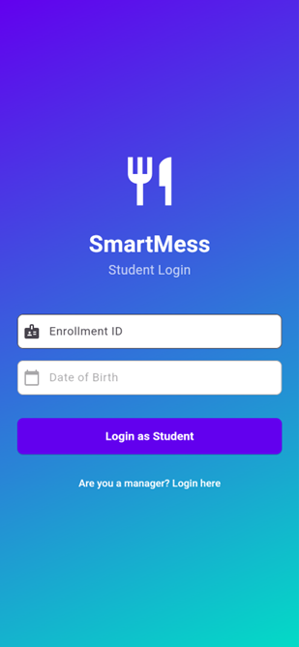
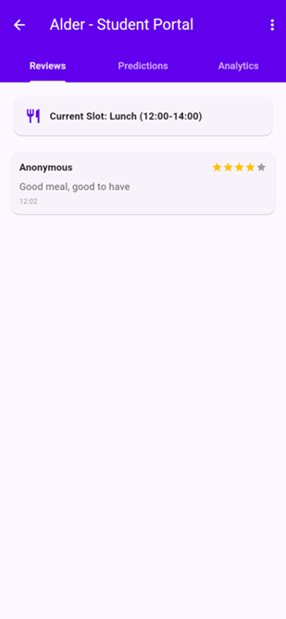

Snapshots of the MVP (Web App)
Student Web Login Screen
Student Home Screen
Student Review View Screen

Slide 13
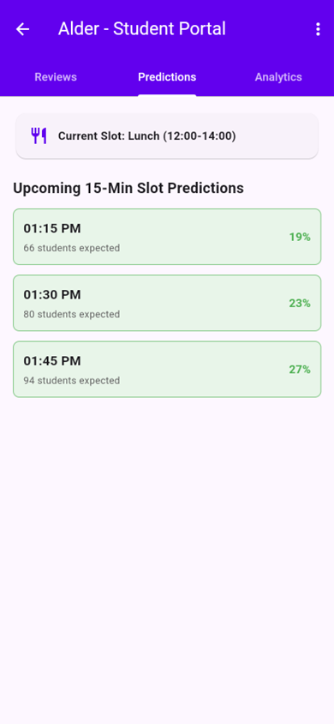
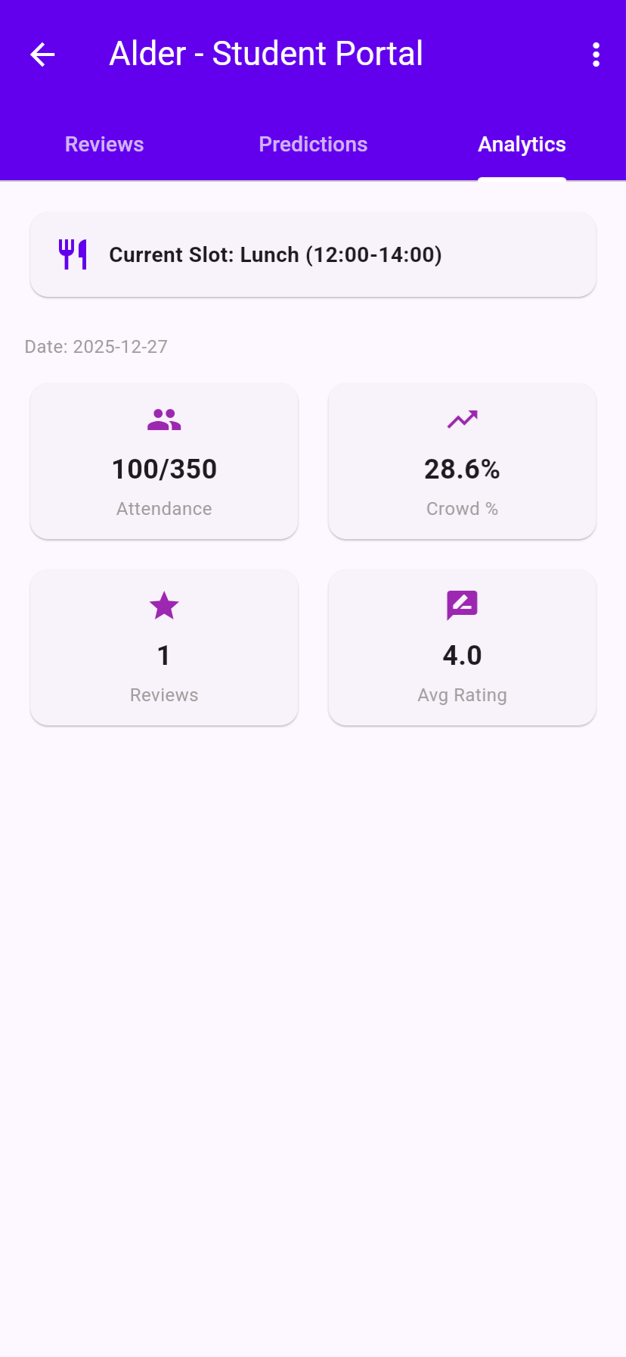
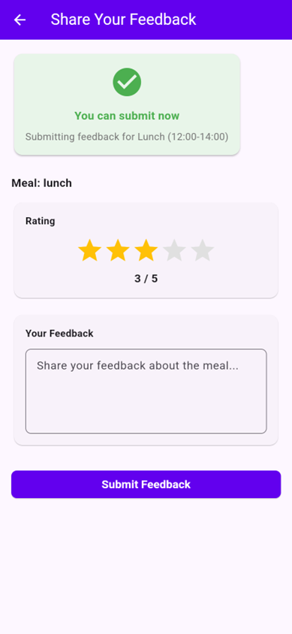
Student Crowd Prediction Screen
Student Analytics Screen
Student Meal Review (Anonymous)

Slide 14
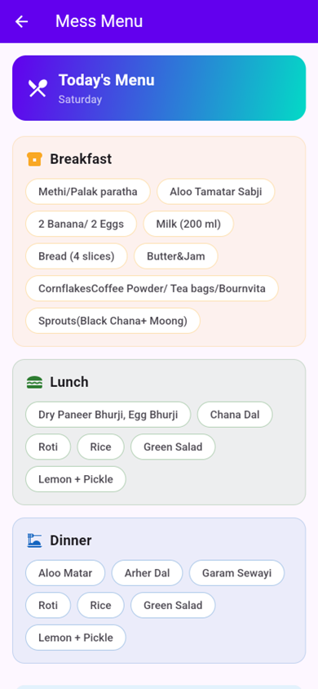
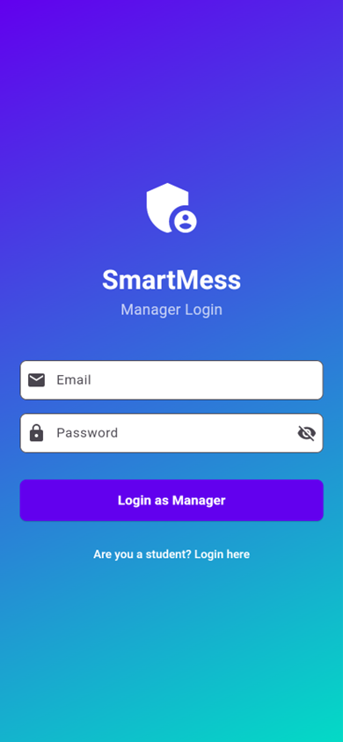

Mess Menu View Screen
Attendance Marking via QR Scan
Manager Web Login Screen

Slide 15
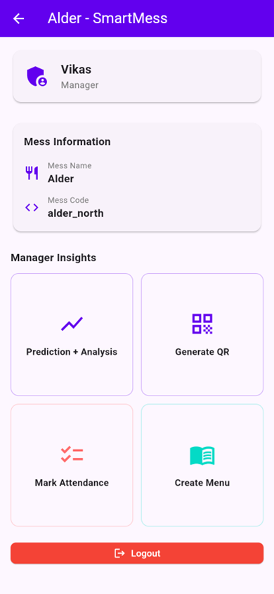
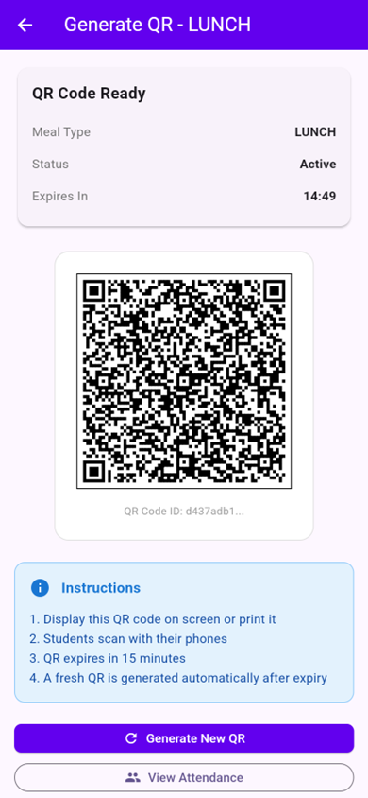
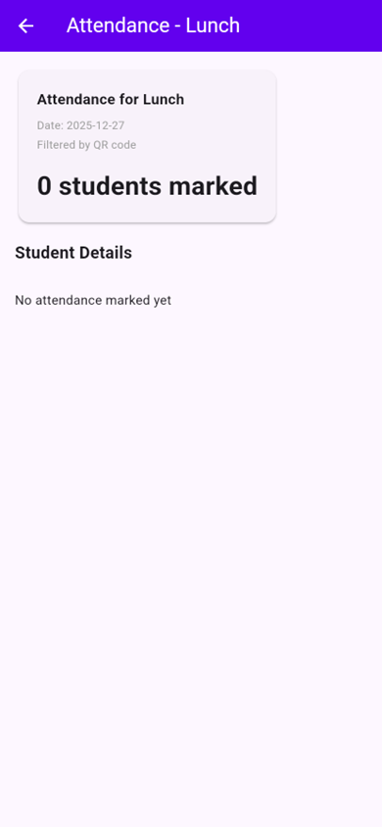
Manager Home Screen
QR Code Generation Screen
Marked Attendance by QR

Slide 16
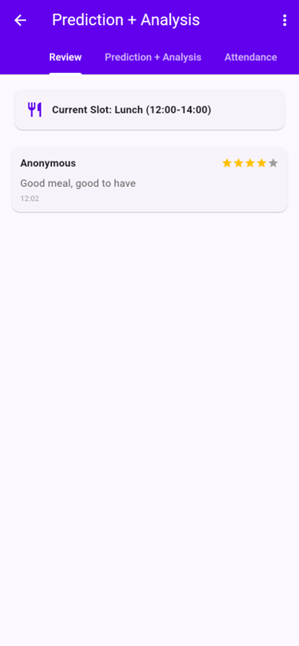
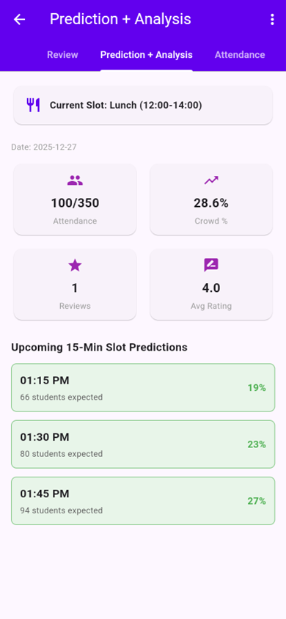
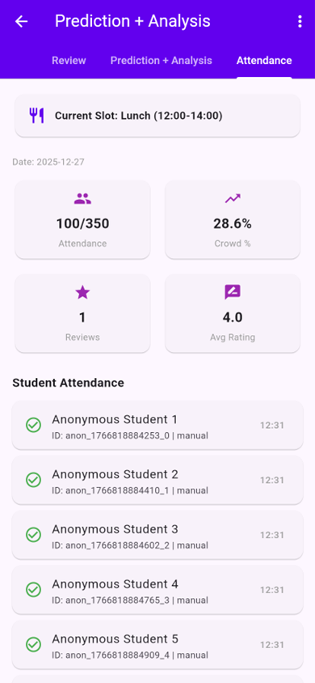
Student Reviews View Screen
Crowd Predictions Screen
All Marked Attendance

Slide 17
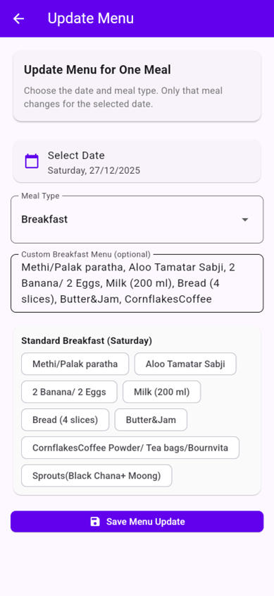
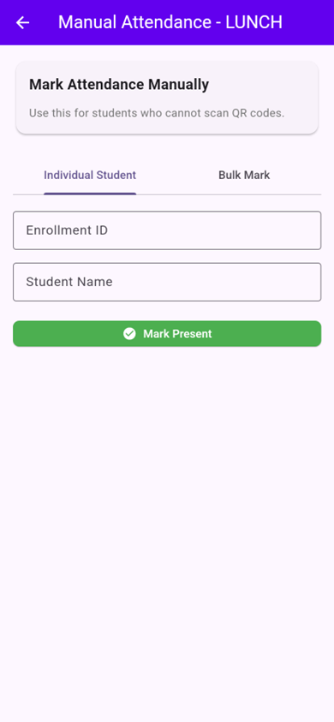
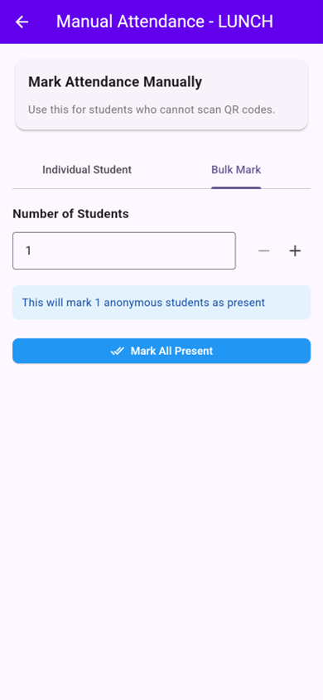
Menu Update Screen
Manual Attendance Marking
Bulk Attendance Marking

Slide 18
Additional Details/Future Development (if any)
Authentication Methodology MUST be improved
Currently, For student’s authentication, DOB is used as password and Enrollment ID as login IDs, both the data is currently, stored directly in the database without hashing for simplicity and manual data addition at the database itself.
Same goes for Manager’s login too, currently, for testing purposes, a dummy email and dummy password is hardcoded directly in the database
In the real, functioning model of the Project, there will be a dedicated Admin Page, where services like adding Manager’s data will be there, and through that mechanism, the passwords will be stored perfectly via hashing.

Slide 19
Google Maps API integration
Google Maps API can be integration to show the allotted mess’s location in a web-integrated Map, along with Building details, like A19 3rd Floor for Alder Mess.
This will increase the ease of locating mess for new students
History section for manager’s UI to see past attendance, crowd levels and reviews.
History section for student’s UI to see their past attendance and submitted reviews.
Other Minor fixes:
Adding service for “Forgot Password” in the Manager’s Login Page

Slide 20
Provide links to your:
GitHub Public Repository
Demo Video Link (3 Minutes)
MVP Link

Slide 21

Thank you!

